Slide 1



Scalable Integration of Heterogeneous Financial Data and Functional Programming
A world of financial data, at your fingertips
Dr. Don Syme
Principal Researcher, Microsoft Research

Slide 2
Agenda
The “Information Rich Programming” Problem
- broadly conceived
- and for financial data specifically
A bit about F#
Applying F# scalable data/metadata integration techniques to financial data integration

Slide 3
Proposition 1 We are living in an Information Revolution

Slide 4
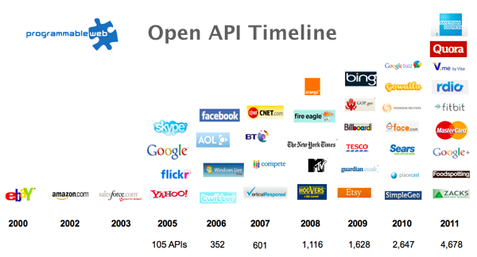
The Information Revolution
2012
2013
6,432
10,537

Slide 5
Proposition 2 Modern programming is intensely information-rich

Slide 6
Proposition 3 Our programming languages are information-sparse

Slide 7

Financial data is like water…

Slide 8
Financial data is like water…
Everyone needs it. Everyone knows where to get it. Simple.
But…
… nobody is sure where it really came from, or goes to.
… nobody really knows its true cost, or true value.
… nobody likes to pay for it, or to share it.
… nobody knows how much is wasted
… nobody knows a good plumber
… nobody knows how bad it is until after you have drunk it

Slide 9

Actually these days it’s more like a flood…

Slide 10
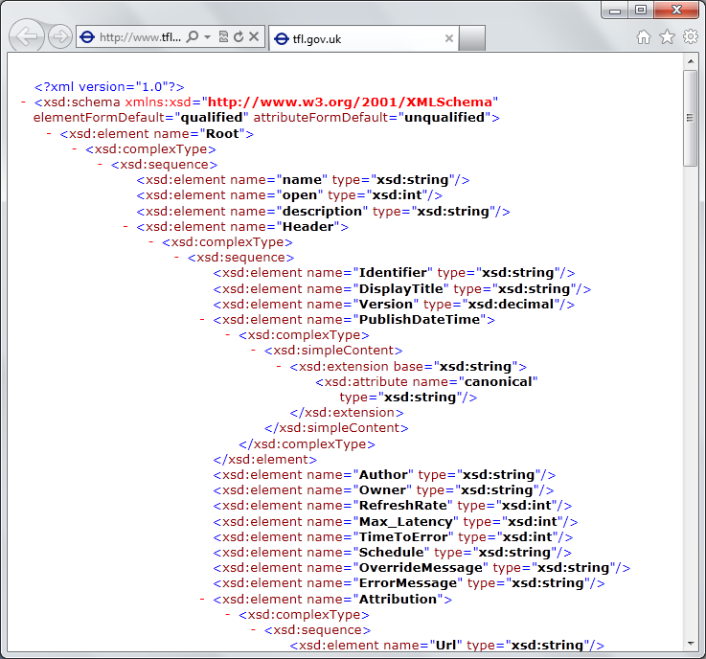
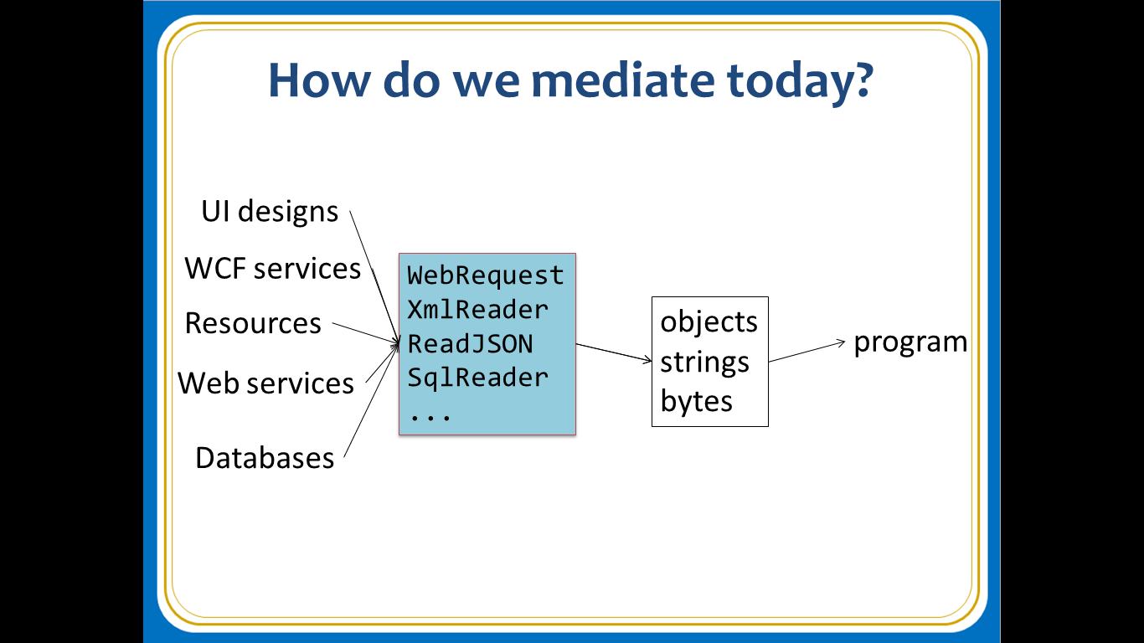
The financial data plumber’s perspective
Languages do not integrate information
Weakly typed
Not at scale
Non-intuitive
Not simple
Disorganised
Static
High friction

Slide 11
We need to bring information into our “data rich” languages… At market-scale, in-cloud or on-premise, strongly tooled, strongly typed

Slide 12
This R&D is done in the context of the open language F#
But before we get into that…
Lots of good reasons for that, see our tech report
“Strongly Typed Language Support for Internet-Scale Information Spaces”

Slide 13
A bit about F#....

Slide 14
F# is free, open source, cross platform fsharp.org

Slide 15
F# is a programming language

Slide 16
F# is a functional-first programming language

Slide 17
F# is a succinct, interoperable, efficient, strongly-typed programming language

Slide 18
F# is a programming language with scalable, seamless data interoperability

Slide 19
"Functional-first programming is a general-purpose programming technique particularly suited to tasks where Time-to-deployment, Efficiency, Correctness and Taming Complexity dominate."

Slide 20
"Examples include executable financial models, market simulators, ETL pipelines, general data-manipulation, calculation engines, service implementation, programmatic Uis, machine-learning and data science. While these problems can be solved using other programming paradigms, they are particularly amenable to functional-first programming."

Slide 21
Functional-first programming uses functional programming as the initial paradigm for most purposes, but employs other techniques such as objects and state as necessary.

Slide 22
F# has an intelligent, fun, contributing community fsharp.org meetup.com/FSharpLondon fsharpforfunandprofit.com

Slide 23
F# helps address real business problems around Time to Market, Efficiency, Correctness and Tackling Complexity See: “Succeeding with Functional-first Programming in Finance”, Don Syme

Slide 24
F# is used to make lots of money fsharp.org/testimonials

Slide 25
Example #1: Energy trading simulation
I have written an application to balance the national power generation schedule … for an energy company.
...the calculation engine was written in F#.
The use of F# to address the complexity at the heart of this application clearly demonstrates a sweet spot for the language … algorithmic analysis of large data sets.
Simon Cousins (EOn)

Slide 26
Example #1: Energy trading simulation
Time to Market
Efficiency
Interoperation ... Seamless. The C# programmer need never know.
Units of measure … a huge time saver...it eradicates a whole class of errors…
Exploratory programming …Working with F# Interactive allowed me to explore the solution space more effectively.
Unit testing …a joy to test. There are no complex time-dependent interactions to screw things up….
Parallelism …The functional purity ... makes it ripe for exploiting the inherent parallelism in processing vectors of data.
Code reduction… … vectors and matrices…higher order functions eat these for breakfast with minimal fuss, minimal code. Beautiful.
Lack of bugs… Functional programming can feel strange. .. once the type checker is satisfied that’s often it, it works.
Correctness
Time to Market
Time to Market
Correctness
Correctness

Slide 27
Example #2: F# for Quant Consulting
Complexity
Our bids for tendered contracts in quantitative finance are regularly half the price of competitors because of the increased productivity we get from F#.
We are regularly able to deliver correct, robust, performant solutions on-time, which is what our customers value most.
Daniel Egloff, QuantAlea Consulting, Zurich
Efficiency
Time to Market
Correctness
http://fsharp.org/testimonials

Slide 28
Microsoft recommend F# and the Visual F# tools for your functional-first programming needs (note: works seamlessly with C#, can interoperate with C/C++/R/Python/…)

Slide 29
Back to the main topic…

Slide 30
Typical F# Topics
F# Basics
F# + Excel
F# for DSLs in Risk and Insurance
F# for GPUs
F# for Pricing
F# + R
F# for Data Science
F# Deep Data Integration

Slide 31
The Problem We’re Addressing Our data plumbing tools are data-sparse. We need to bring financial information into the language… At market-scale, strongly tooled, strongly typed

Slide 32
Which data? Xenomorph Timescape is a major Microsoft partner for Financial Data in the Azure Cloud Platform
Data like this enables entire cloud-based industries in financial analytics

Slide 33
The specific questions: Can we use F#’s unique “type provider” capabilities to integrate Xenomorph data at fine granularity? Can we specifically tackle the quantity of instruments and the sparseness of the data in a programming language integration.

Slide 34
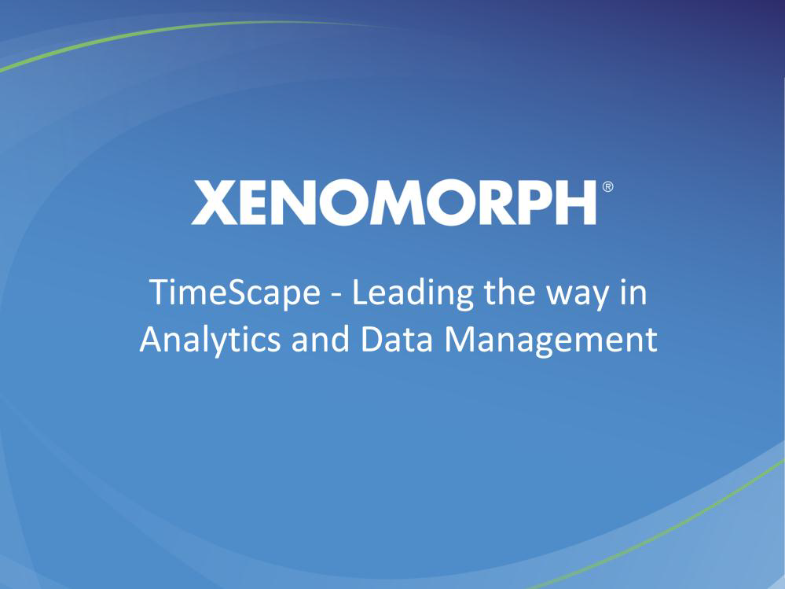

Slide 35
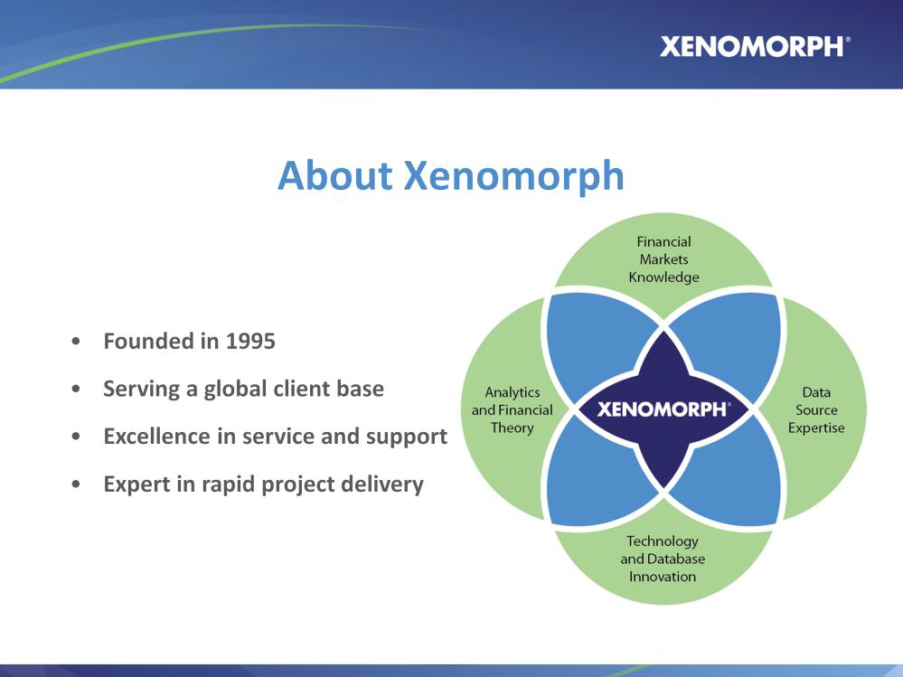

Slide 36
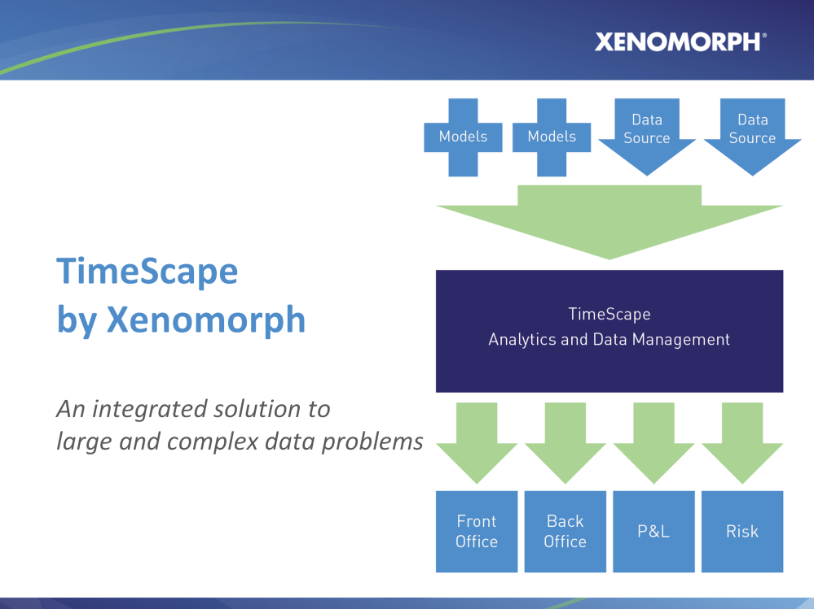

Slide 37
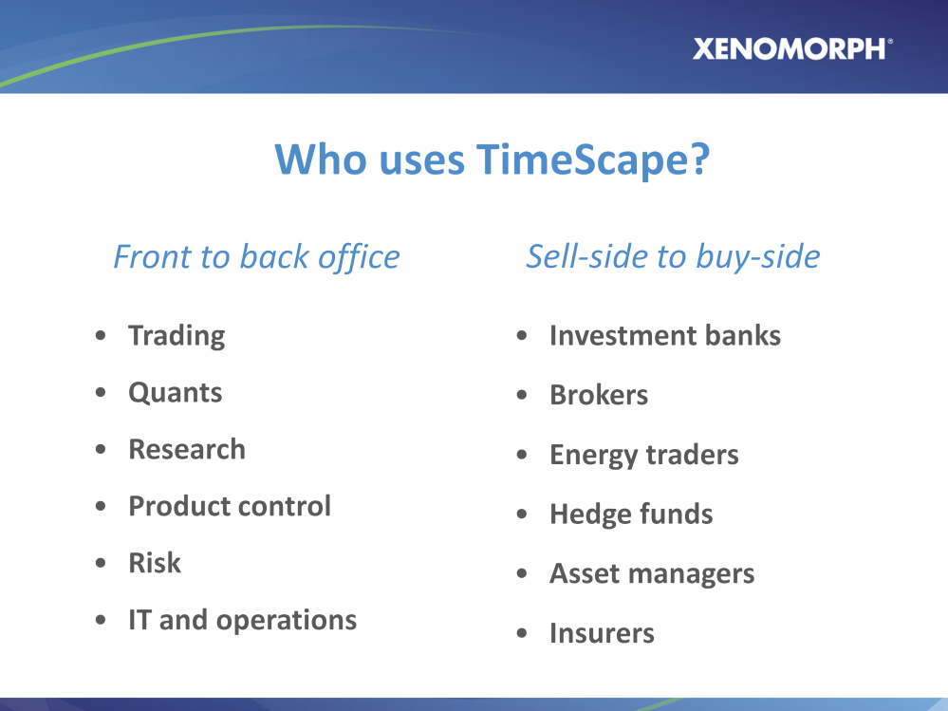

Slide 38
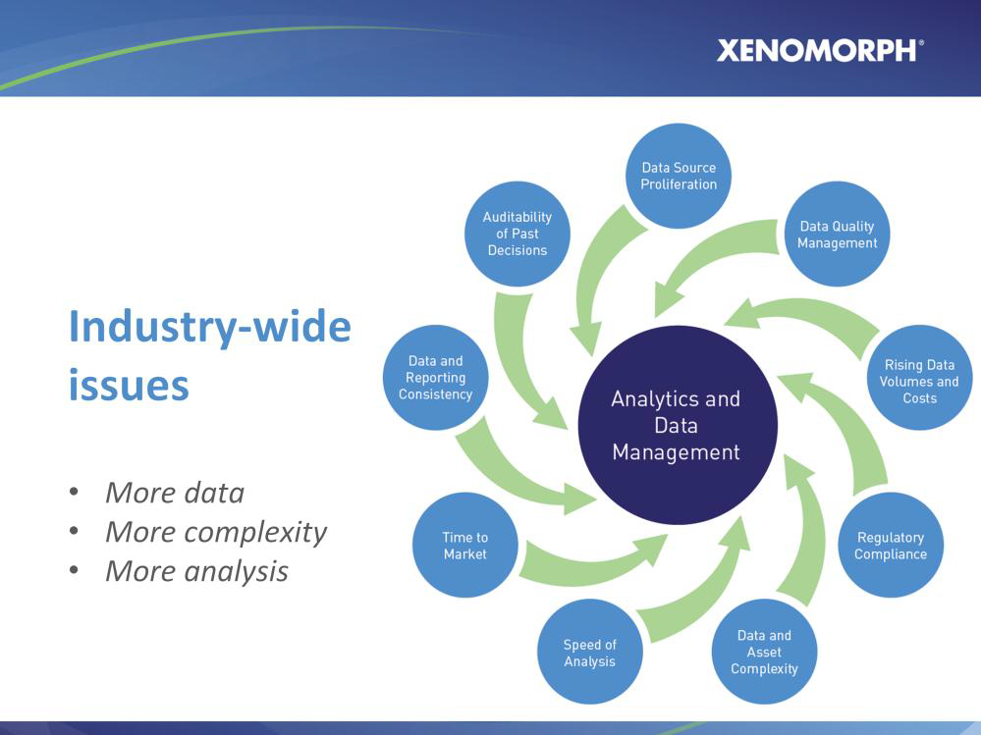

Slide 39
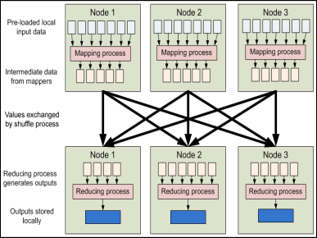


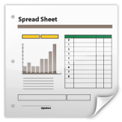
Data Provider
Data Provider
Data Access Layer
Data Provider
Data Provider
Data Provider
Data Provider
Analytics
Provider
Analytics Provider
Data Analytics Layer
Data
Analytics Provider
HPC Server
Model Provider
Model Provider
Instrument Analytics Layer
Instrument
Analytics Provider
Query Layer
Layer
Layer
Third Party Services
Risk App
Trading App
Spreadsheet
Risk App
Trading App
Spreadsheet

Slide 40
The problem is this: the data is still weakly integrated into our programming languages

Slide 41
The Technique: “F# Type Providers” Allow scalable, robust, deep integration

Slide 42
Similar Problem: Integrate all of freebase.com “as if it were a library” 40M entities, 1Billion facts, 24,000 types, 65,000 properties

Slide 43
Similar Problem: Integrate all of worldbank.org/data “as if it were a library” 10,000+ time series for hundreds of countries/regions

Slide 44
Demo
F# + Freebase
An F# type provider for deep, robust integration of web data

Slide 45
A Type Provider is…. “Just like a library” “A design-time component that computes a space of types and methods on-demand…” “An adaptor between data/services and the F# type system…” “On-demand, scalable compile-time provision of type/module definitions…”

Slide 46
But what about financial data?

Slide 47
Demo
F# + Xenomorph TimeScape
An F# type provider for deep, robust integration of financial data

Slide 48
Theme #1 On-Demand Types = Internet Scalable Magic

Slide 49
On-Demand Type Provision
let data = RiskLab.GetDataContext()
1. Compiler/IDE requests metadata for symbol GetDataContext
Provider reports return type of RiskLabDataContext
data.Categories
2. Compiler/IDE requests contents of RiskLabDataContext and property Categories
Provider asks Freebase metadata service for top-level domains
Provider reports top-level domains of Freebase as properties of the type
data.Categories.``GB Equities``
3. Compiler/IDE requests metadata for symbol ``GB Equities``
...

Slide 50
Theme #2 Many Data Sources, One Mechanism

Slide 51
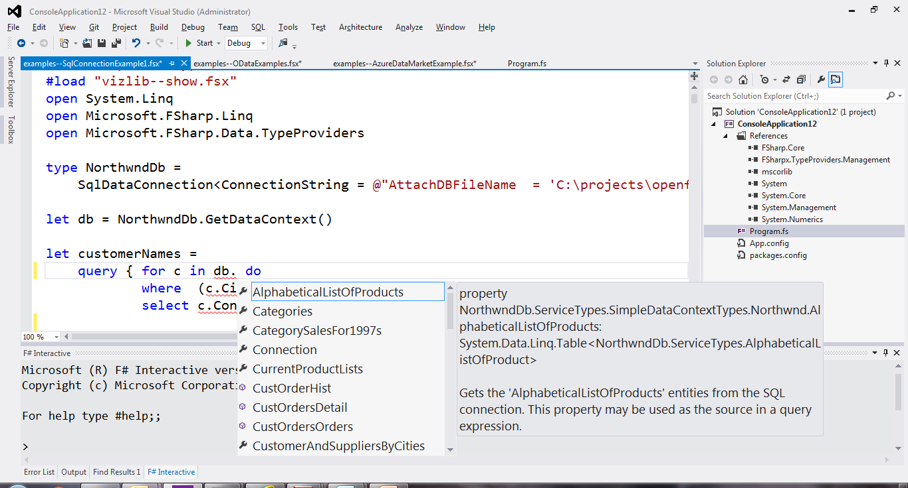
SQL

Slide 52
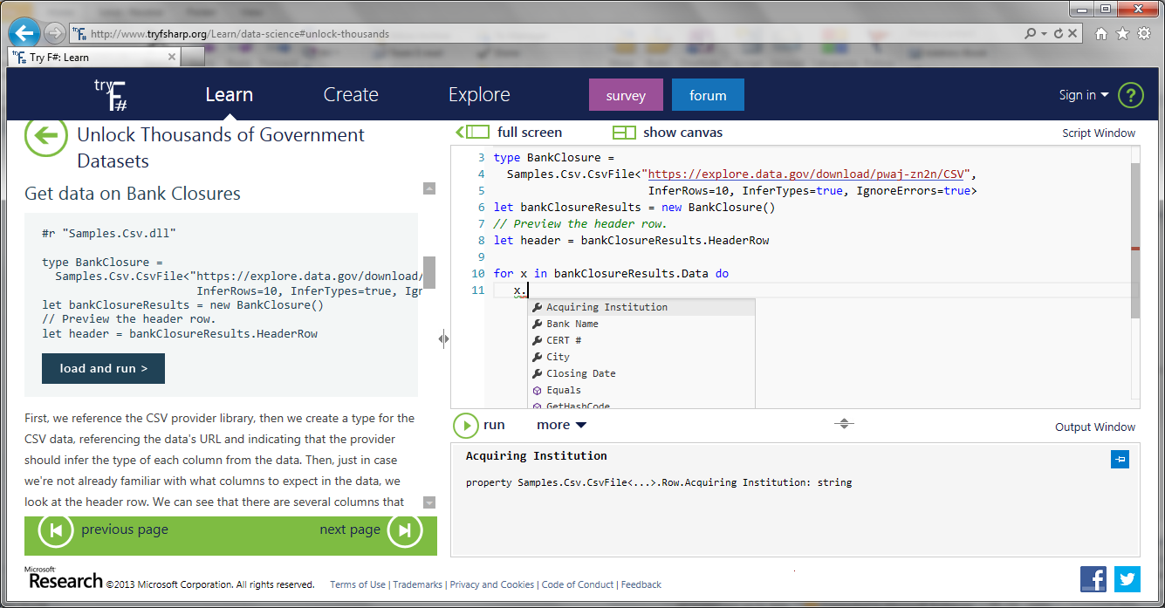
CSV

Slide 53
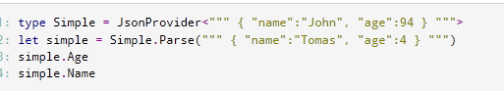
JSON

Slide 54
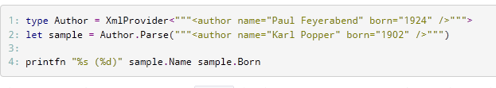
XML

Slide 55
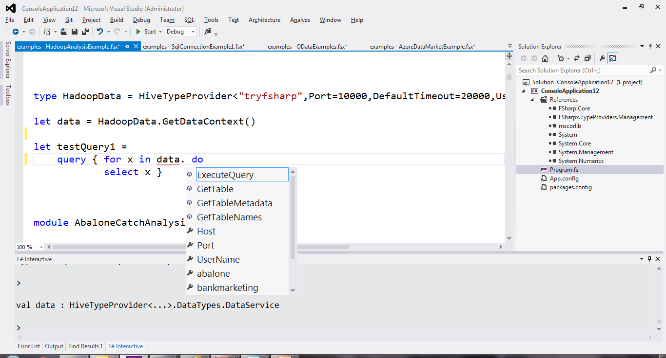
Hadoop/Hive

Slide 56
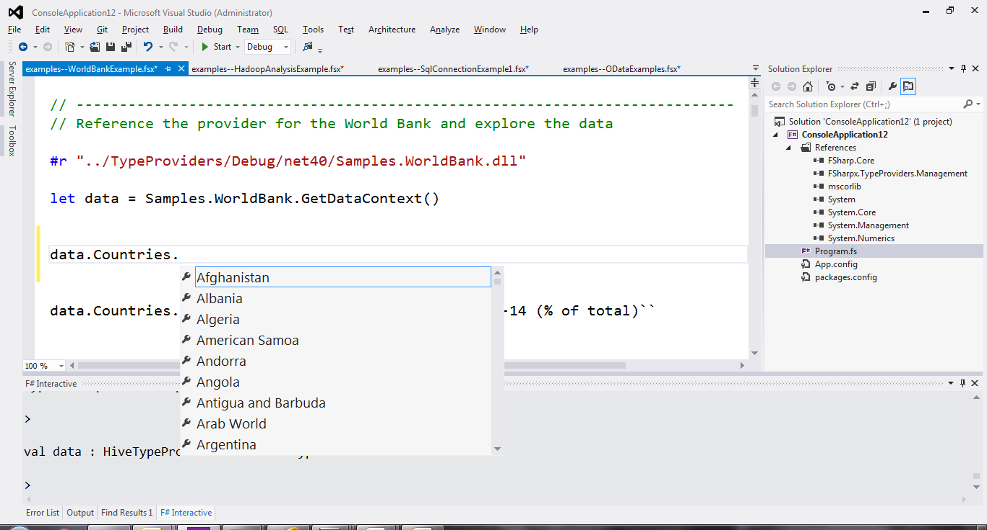
World Bank

Slide 57
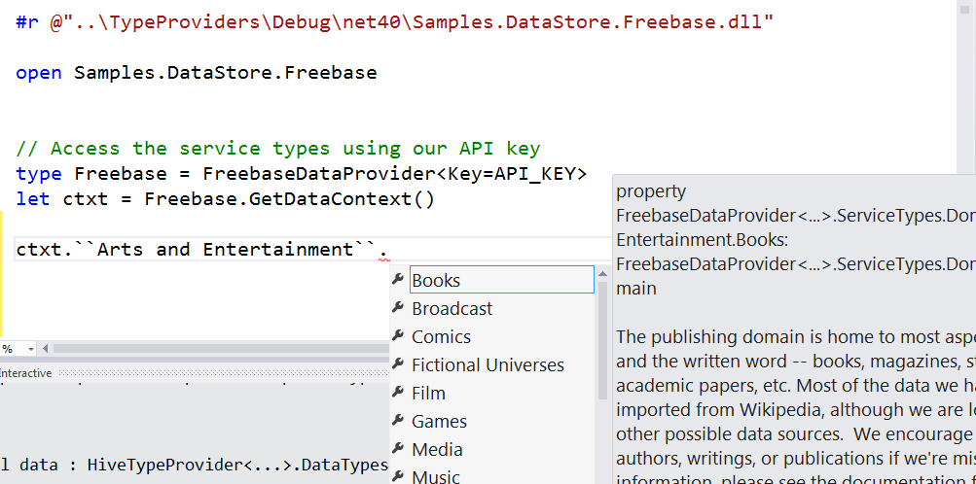
Freebase

Slide 58
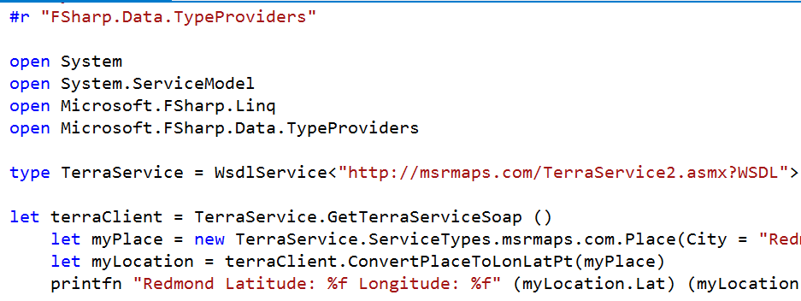
WSDL

Slide 59
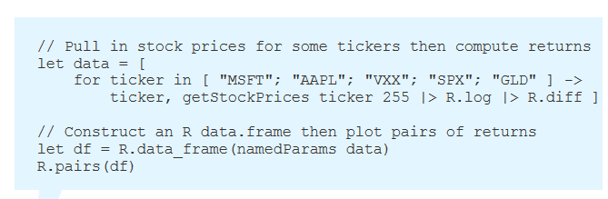
R

Slide 60
Demo
F# + R

Slide 61
Theme #3 Data and Types at Multiple Scales

Slide 62
Data at Multiple Scales
From Everything to Individuals
Data Scripters need to work with different granularities of schematization
data.AllEntites
data.Categories.``GB Equity``
data.Categories.``GB Equity``.``SAINSBURY(J) (SBRY.L, Reuters)``
…Only a language with massively scalable metadata integration can operate at all these levels
Every stable entity can get a unique type

Slide 63
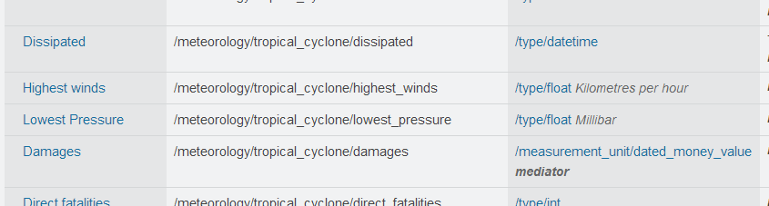
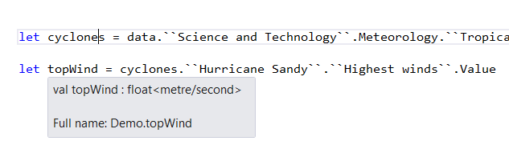
Providing Units of Measure
If the metadata contains units (including currencies)…
via F#’s Units of Measure
…then these can be projected into the programming language.

Slide 64
Theme #4 Reactive Streaming Not covered today, but F# and .NET has excellent compositional primitives for reactive, streaming data, and provided data sources can easily make use of these

Slide 65
Integrating with Other Systems?

Slide 66
Typical F# Topics
F# Basics
F# + Excel
F# for DSLs in Risk and Insurance
F# for GPUs
F# for Pricing
F# + R
F# for Data Science
F# Deep Data Integration

Slide 67
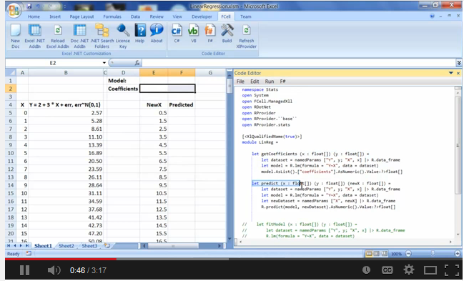
Functional + R + Excel Integration via fcell.io

Slide 68
Typical F# Topics
F# Basics
F# + Excel
F# for DSLs in Risk and Insurance
F# for GPUs
F# for Pricing
F# + R
F# for Data Science
F# Deep Data Integration

Slide 69

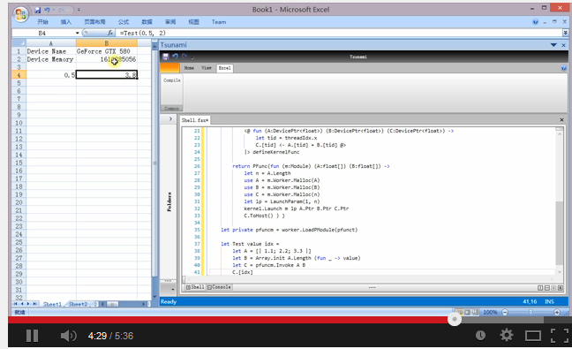
Functional + GPGPU
F# + FCell +

Slide 70
Summary
Financial programming is ever more integrated with data
I presented techniques for scalable, intuitive integration of financial data+metadata
Integrating data+programming has many challenges
You can use these techniques for real and in production through F#

Slide 71
To find out more…
Learn F# at tryfsharp.org (including financial)
Lots of resources at fsharp.org
Testimonials at fsharp.org/testimonials
Over 100 videos at fsharp.org/videos

Slide 72

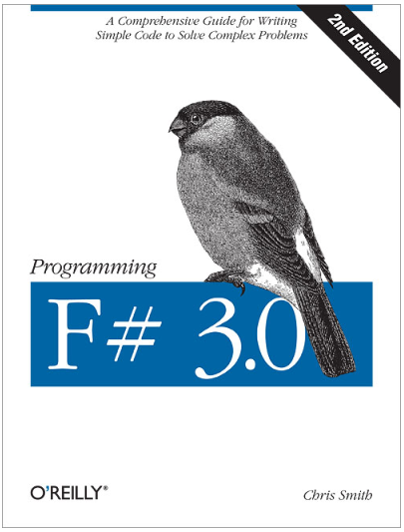
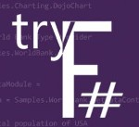

Questions?
tryfsharp.org

Slide 73
Some Research Questions Which Arise
Can we incorporate schema change policies into these type systems?
Can historical and probabilistic metadata be useful for typing or tooling?
Can we apply these techniques at the scale of Bloomberg and Reuters?
Temporal types? Probabilistic types? Table types?
Can we apply these techniques to real-time data streams?
Is there an interplay between provided types and machine learning models?
Can richer constraints and provenance annotations be provided?

Slide 74
Theme #5 Queries Full XTS QL not yet supported in prototype Similar query languages (Freebase MQL) are well explored

Slide 75
Theme #4 Type Systems Encounter Reality

Slide 76
This is different…
“The idea of integrating internet-scale information services directly into the program's variable and type space is probably the most innovative programming language idea I’ve heard of in a decade” (Jim Cordy, Queens U)
Perhaps, perhaps not…
But if something so simple is perceived as so different, we need think why
(What follows is somewhat whimsical)

Slide 77
This is different…
We like to see PL systems as logical systems
Traditional logical systems exclude interaction with reality
This is a powerful and simplifying assumption
It is also fundamentally wrong for modern applied programming languages

Slide 78


Γ $⊢ e$ : τ
Lots of work here
Lots of work here
The exclusion of reality!
The neglected child
Γ₀ = 0

Slide 79
Meditations on Γ₀
Γ₀ is the ever-growing ocean of digital reality around us
Γ₀ is big. Really big.
Γ₀ defies imagination for its enormity
Γ₀ is other. It doesn’t speak your language
Γ₀ is being organized at an incredible rate
Γ₀ needs us. We’re hitting the limit with e and tau
Γ₀ is surprisingly “human”

Slide 80
Meditations on Γ₀
Γ₀ is full of uncertainty and probabilities.
You are mutually recursive with Γ₀. You are part of it.
Γ₀ has many open doors, many locked doors
Γ₀ has many, many parts that do not get on particularly well.
Γ₀ is so real you want to touch it, explore it
Don’t look too long.
It’s like staring at infinity

Slide 81
In Summary
F#
The safe choice for functional-first
Unbeatable data integration
Visual F# - tooling you can trust from Microsoft
Open, cross-platform, strongly typed, efficient, rock-solid stable

Slide 82
Theme #5 Schema Change

Slide 83
A problem, but…
Many, many data sources are surprisingly stable
Some data sources support “snapshot dates”
F# supports “invalidation signals” from providers at design-time
Erasure makes compiled code much less fragile

Slide 84
The Recurring Business Problems
Time to Market
Efficiency
Correctness
Complexity
for analytical components

Slide 85
Is Time to Market a Problem? Late Models → Missed market opportunities Late Services → Users have gone elsewhere Late Components → Millions evaporate
Financial model
Gaming service
Ad ranking engine
Notes:
“Take a moment to stop and think about the ramifications of time-to-market problems through software delays in analytical components for QF, FE, Trading and Calculation Engines more broadly”

Slide 86
Is Correctness a Problem? Buggy Models → Major risks to institutions Buggy Services → Users walk away Buggy Analytical Components → Millions leak away
Quant model
Gaming service
Ad ranking engine
Notes:
“Take a moment to stop and think about the ramifications of correctness problems through software delays in analytical components for QF, FE, Trading and Calculation Engines more broadly”

Slide 87
Is Efficiency a Problem? Slow Models → Can’t assess the institution daily Slow Services → Massive loss of online business Slow Analytical Components → Can’t scale to web
Financial model
Insurance quote service
Ad ranking engine
Notes:
“Take a moment to stop and think about the ramifications of efficiency problems through software delays in analytical components for QF, FE, Trading and Calculation Engines more broadly”

Slide 88
Is Complexity a Problem? Intractable Models → Can’t enter markets Intractable Services → Can’t deliver services Intractable Analytical Components → Can’t deliver
Notes:
“Take a moment to stop and think about the ramifications of efficiency problems through software delays in analytical components for QF, FE, Trading and Calculation Engines more broadly”

Slide 89
The Recurring Business Problems
Time to Market
Efficiency
Correctness
Complexity
for analytical components and services

Slide 90
What’s the Need? Analytical programmers delivering correct, efficient components in the enterprise, on-time This is a primary set of problems that functional-first programming helps solve

Slide 91
Example #1 (power company)
I have written an application to balance the national power generation schedule … for an energy company.
...the calculation engine was written in F#.
The use of F# to address the complexity at the heart of this application clearly demonstrates a sweet spot for the language … algorithmic analysis of large data sets.
Simon Cousins (Eon Powergen)

Slide 92
180,000
lines of OO
became
7,000
lines of robust F#, with
parallel +more features

Slide 93
Example #2: F# in Insurance
Time to Market
Complexity
I work for a large actuarial company... …Despite adopting Agile/Scrum …the usual delays, complications and sometimes …failures.
We used F#, and quickly created a system which would perform the necessary calculations highly efficiently, in parallel, and with a perfect match to the spreadsheet results.
All of the advantages which are commonly touted for F# do play out in practice. Immutability, Easy Parallelisation, Expressiveness, Testability, Conciseness, Flexibility, Productivity
[ Company name omitted ]
Efficiency
Correctness
fsharp.org/testimonials

Slide 94
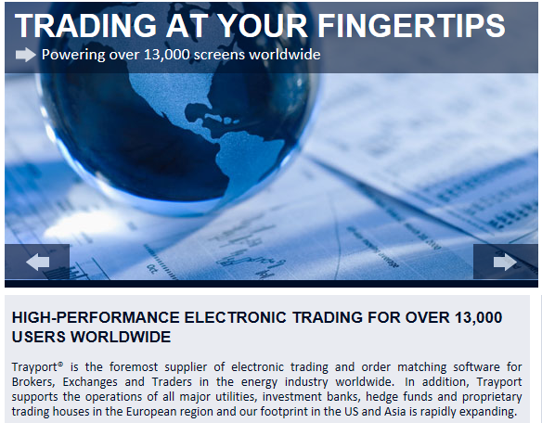
Example #3: Finance trading platform
F# + C# for Trading Front End
Leverage F#’s features:
- extensive type system
- asynchronous workflows, agents and immutable types
- rich pattern matching and parser support
“Experienced F# developers regularly solve problems in days that would take weeks using more traditional languages…solving complex problems in an elegant and highly maintainable manner”
Phil Trelford, Trayport
Time to Market
Complexity

Slide 95
Example #4: F# for Quant Consulting
Our bids for tendered contracts in quantitative finance are regularly half the price of competitors because of the increased productivity we get from F#.
We are regularly able to deliver correct, robust, performant solutions on-time, which is what our customers value most.
Daniel Egloff, QuantAlea Consulting, Zurich
Efficiency
Time to Market
Correctness
http://fsharp.org/testimonials

Slide 96
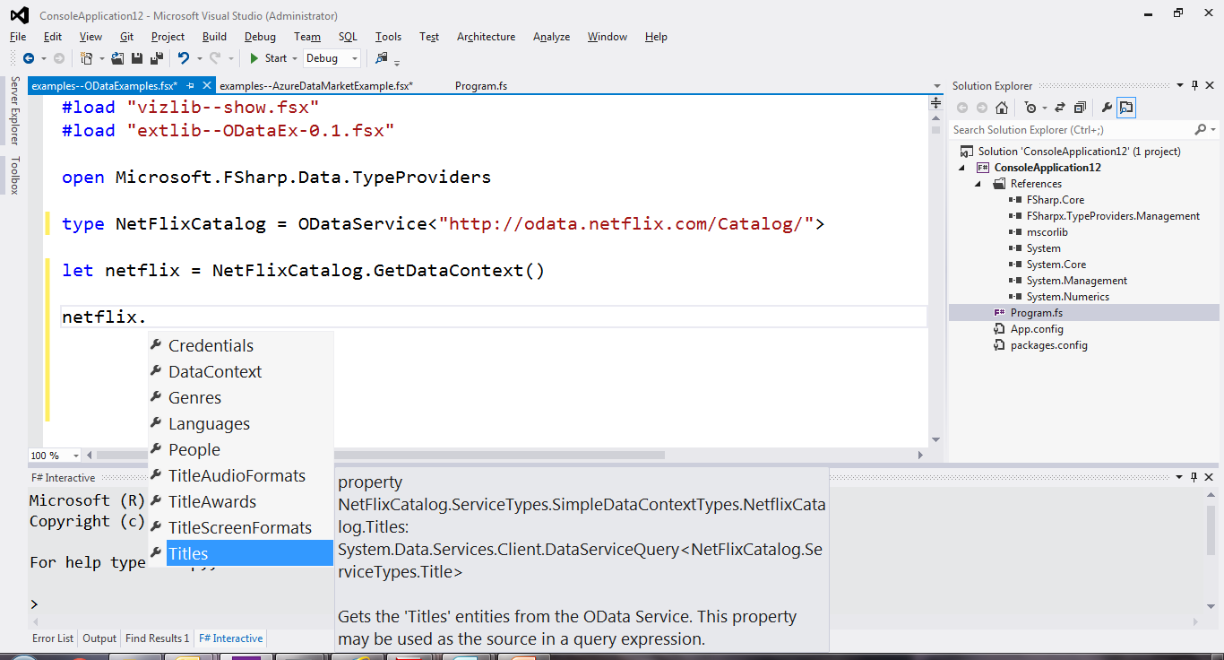
OData

